Slide 1
Topic 2:
Variables, Design of Programs and Logic

Slide 2
Objectives
In this chapter, you will learn about:
Modular programs
Programming style
Data types
Arithmetic operations
Variables and declaration statements
Common programming errors
C++ for Engineers and Scientists, Fourth Edition

Slide 3
Introduction to C++
Modular program: A program consisting of interrelated segments (or modules) arranged in a logical and understandable form
  Easy to develop, correct, and modify
Modules in C++ can be classes or functions
C++ for Engineers and Scientists, Fourth Edition

Slide 4
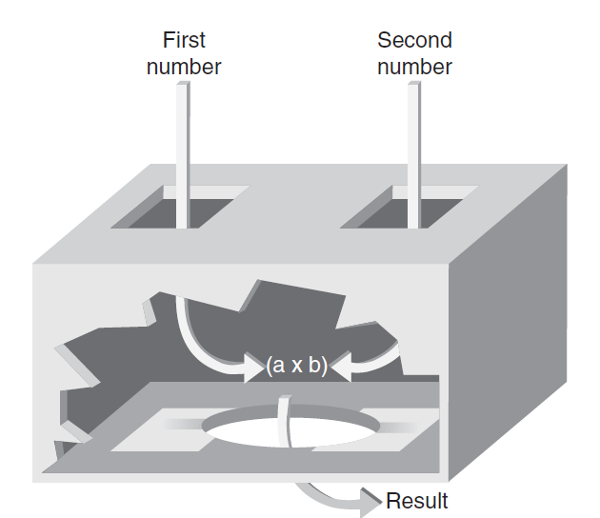

Introduction to C++ (continued)‏
Function: Accepts an input, processes the input, and produces an output
  A function’s processing is encapsulated and hidden within the function
C++ for Engineers and Scientists, Fourth Edition

Slide 5
Introduction to C++ (continued)‏
Class: Contains both data and functions used to manipulate the data
Identifier: A name given to an element of the language, such as a class or function
  Rules for forming identifier names:
    First character must be a letter or underscore
    Only letters, digits, or underscores may follow the initial letter (no blanks allowed)‏
    Keywords cannot be used as identifiers
    Maximum length of an identifier = 1024 characters
C++ for Engineers and Scientists, Fourth Edition

Slide 6
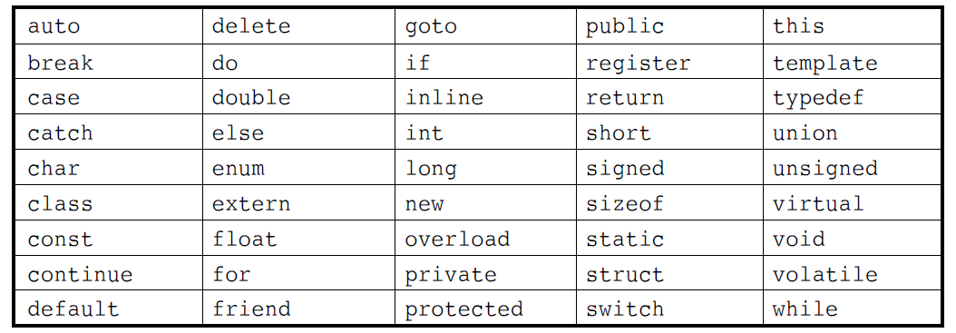
Introduction to C++ (continued)‏
Keyword: A reserved name that represents a built-in object or function of the language
Table 2.1: Keywords in C++
C++ for Engineers and Scientists, Fourth Edition

Slide 7
Introduction to C++ (continued)‏
Examples of valid C++ identifiers:
  degToRad intersect addNums
  slope bessell multTwo
  findMax density
Examples of invalid C++ identifiers:
  1AB3 (begins with a number)‏
  E*6 (contains a special character)‏
  while (this is a keyword)‏
C++ for Engineers and Scientists, Fourth Edition

Slide 8
Introduction to C++ (continued)‏
Function names
  Require a set of parentheses at the end
  Can use mixed upper and lower case
  Should be meaningful, or be a mnemonic
Examples of function names:
easy() c3po() r2d2() theForce()‏
Note that C++ is a case-sensitive language!
C++ for Engineers and Scientists, Fourth Edition

Slide 9
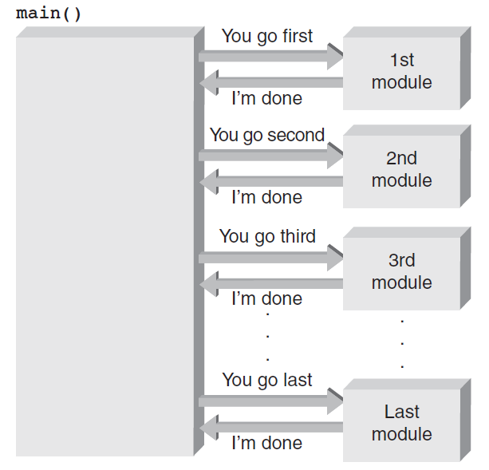
The main() Function
Overall structure of a C++ program contains one function named main(), called the driver function
All other functions are invoked from main()‏
Figure 2.3 The main() function directs all other functions.
C++ for Engineers and Scientists, Fourth Edition

Slide 10
The main() Function (continued)‏
Function header line: First line of a function, which contains:
  The type of data returned by the function (if any)‏
  The name of the function
  The type of data that must be passed into the function when it is invoked (if any)‏
Arguments: The data passed into a function
Function body: The statements inside a function
  enclosed in braces
C++ for Engineers and Scientists, Fourth Edition

Slide 11
The main() Function (continued)‏
Each statement inside the function must be terminated with a semicolon
return: A keyword causing the appropriate value to be returned from the function
The statement return 0 in the main() function causes the program to end
C++ for Engineers and Scientists, Fourth Edition

Slide 12
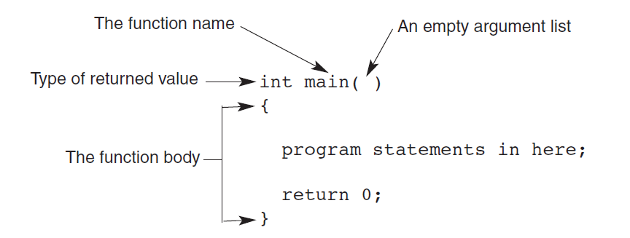
The main() Function (continued)‏
Figure 2.4 The structure of a main() function
C++ for Engineers and Scientists, Fourth Edition

Slide 13
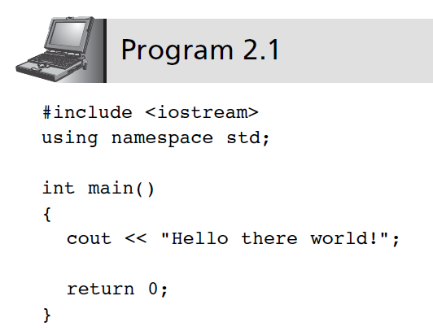
The cout Object
cout object: An output object that sends data to a standard output display device
C++ for Engineers and Scientists, Fourth Edition

Slide 14
The cout Object (continued)‏
Preprocessor command: Starts with a #
  Causes an action before the source code is compiled into machine code
#include <file name>: Causes the named file to be inserted into the source code
C++ provides a standard library with many pre-written classes that can be included
Header files: Files included at the head (top) of a C++ program
C++ for Engineers and Scientists, Fourth Edition

Slide 15
The cout Object (continued)‏
using namespace <namespace name> : Indicates where header file is located
  Namespaces qualify a name
    A function name in your class can be the same as one used in a standard library class
String: Any combination of letters, numbers, and special characters enclosed in double quotes
Delimiter: A symbol that marks the beginning and ending of a string; not part of the string
C++ for Engineers and Scientists, Fourth Edition

Slide 16
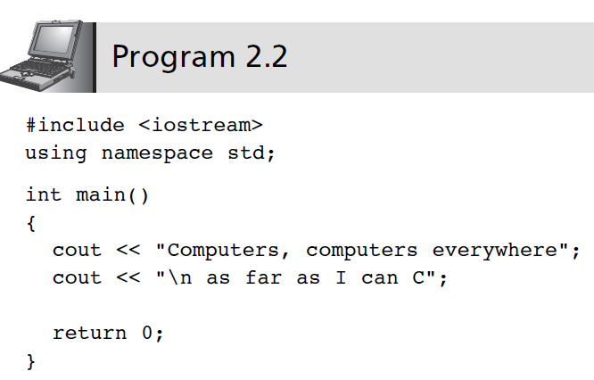
The cout Object (continued)‏
C++ for Engineers and Scientists, Fourth Edition

Slide 17
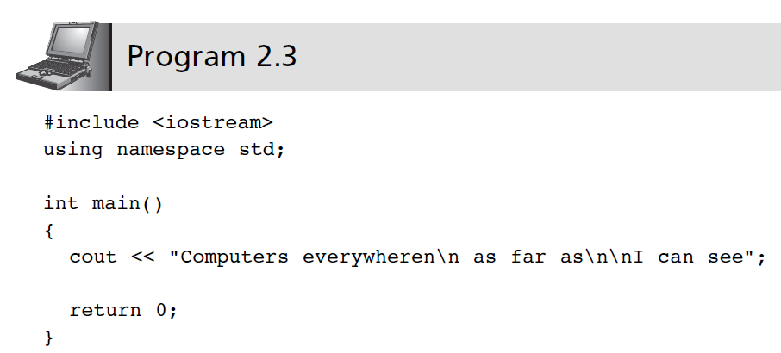
The cout Object (continued)‏
Escape sequence: One or more characters preceded by a backslash, \
C++ for Engineers and Scientists, Fourth Edition

Slide 18
Programming Style
Good style calls for one C++ statement per line
Opening and closing braces {} for the function body should each be on separate lines
Statements in the function body should be indented
C++ for Engineers and Scientists, Fourth Edition

Slide 19
Comments
Comments: Explanatory remarks in the source code added by the programmer
Line comment: Begins with // and continues to the end of the line
    Example: // this program displays a message
        #include <iostream>
        using namespace std;
        int main ()
        {
        cout << “Hello there world!”; //displays text
        return 0;
        }
C++ for Engineers and Scientists, Fourth Edition

Slide 20
Comments (continued)‏
Block comments: comments that span across two or more lines
  Begin with /* and end with */
  Example:
  /* This is a block comment that
  spans
  across three lines */
C++ for Engineers and Scientists, Fourth Edition

Slide 21
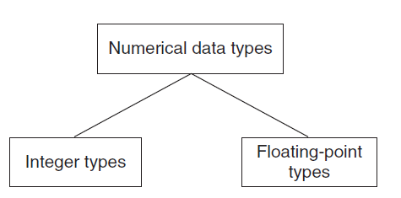
Data Types
Data type: A set of values and the operations that can be applied to these values
Two fundamental C++ data groupings:
  Class data type (a class): Created by the programmer
  Built-in data type (primitive type): Part of the C++ compiler
Figure 2.5 Built-in data types
C++ for Engineers and Scientists, Fourth Edition

Slide 22
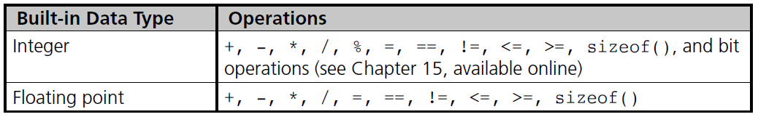
Data Types (continued)
C++ for Engineers and Scientists, Fourth Edition

Slide 23
Data Types (continued)‏
Literal (constant): An actual value
  Examples:
3.6 //numeric literal
“Hello” //string literal
Integer: A whole number
C++ has nine built-in integer data types
  Each provides different amounts of storage (compiler dependent)
C++ for Engineers and Scientists, Fourth Edition

Slide 24
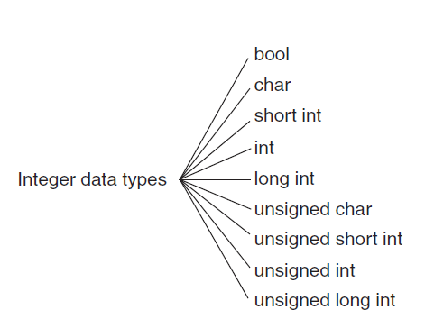
Integer Data Types
Figure 2.6 C++ integer data types
C++ for Engineers and Scientists, Fourth Edition

Slide 25
Integer Data Types (continued)‏
int data type: Whole numbers (integers), optionally with plus (+) or minus (–) sign
  Example: 2, -5
char data type: Individual character; any letter, digit, or special character enclosed in single quotes
  Example: ‘A’
  Character values are usually stored in ASCII code
C++ for Engineers and Scientists, Fourth Edition

Slide 26
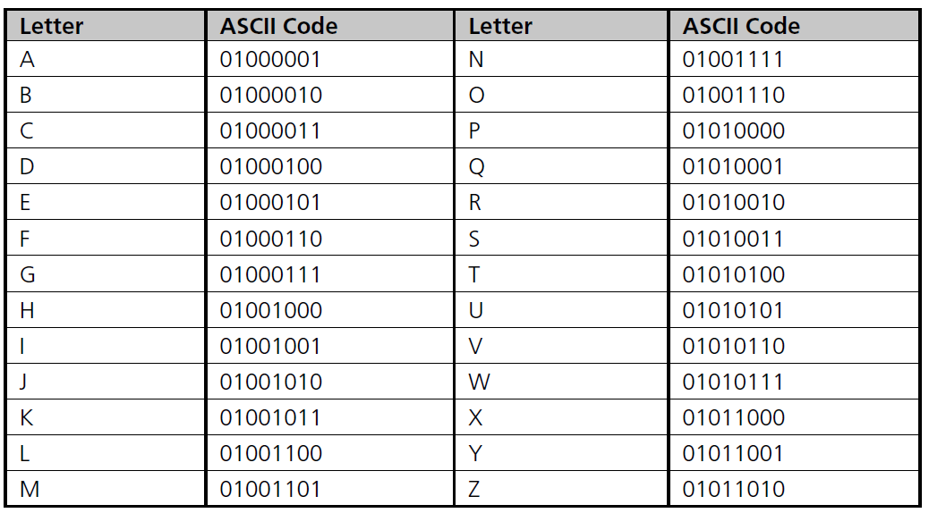
Integer Data Types (continued)‏
Table 2.3 The ASCII Uppercase Letter Codes
C++ for Engineers and Scientists, Fourth Edition

Slide 27
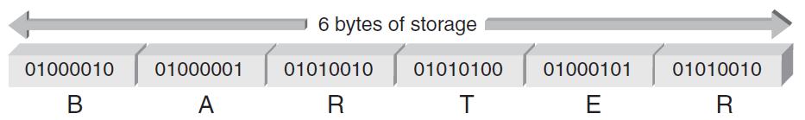
Integer Data Types (continued)‏
When storing the ASCII codes shown in Table 2.3 to represent text, each letter takes one byte of memory and is represented by the associated number from the chart
Figure 2.7 The letters BARTER stored inside a computer
C++ for Engineers and Scientists, Fourth Edition

Slide 28
Integer Data Types (continued)‏
Escape character: The backslash, \
  Indicates an escape sequence
Escape sequence: Tells compiler to treat the following characters as special instruction codes
C++ for Engineers and Scientists, Fourth Edition

Slide 29
Integer Data Types (continued)‏
bool data type: Represents Boolean (logical) data
  Restricted to two values: true or false
  Useful when a program must examine a condition and take a prescribed course of action, based on whether the condition is true or false
C++ for Engineers and Scientists, Fourth Edition

Slide 30
Determining Storage Size
A unique feature of C++ is that you can see where and how values are stored
  sizeof() operator provides the number of bytes used to store values of the data type named in the parenthesis
  Values returned by sizeof() are compiler dependent
C++ for Engineers and Scientists, Fourth Edition

Slide 31
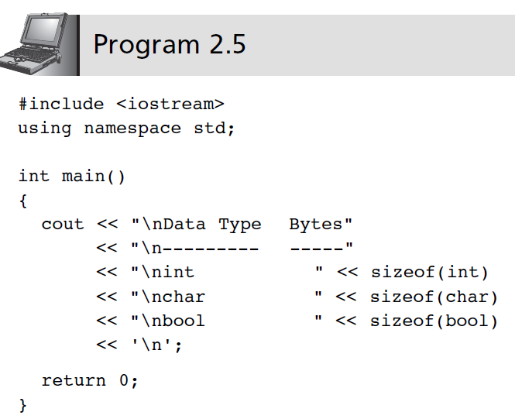
Determining Storage Size (continued)‏
C++ for Engineers and Scientists, Fourth Edition

Slide 32
Signed and Unsigned Data Types
Signed data type: One that permits negative, positive, and zero values
Unsigned data type: Permits only positive and zero values
  An unsigned data type provides essentially double the range of its signed counterpart
C++ for Engineers and Scientists, Fourth Edition

Slide 33
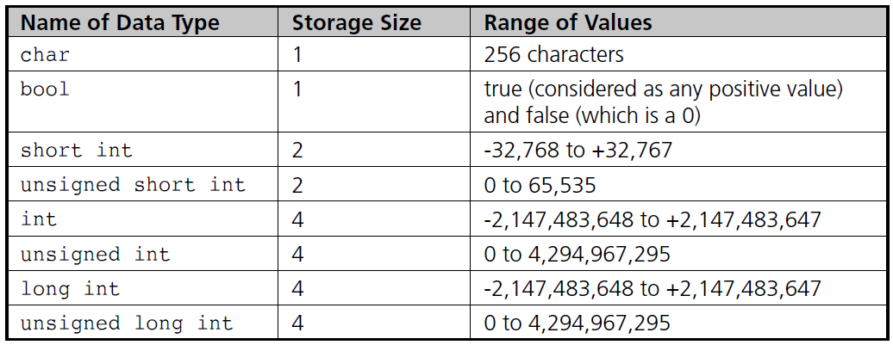
Signed and Unsigned Data Types (continued)‏
Table 2.5 Integer Data Type Storage
C++ for Engineers and Scientists, Fourth Edition

Slide 34
Floating-Point Types
Floating-point number (real number): Zero or any positive or negative number containing a decimal point
  Examples: +10.625 5. -6.2
  No special characters are allowed
  Three floating-point data types in C++:
    float (single precision)‏
    double (double precision)‏
    long double
C++ for Engineers and Scientists, Fourth Edition

Slide 35
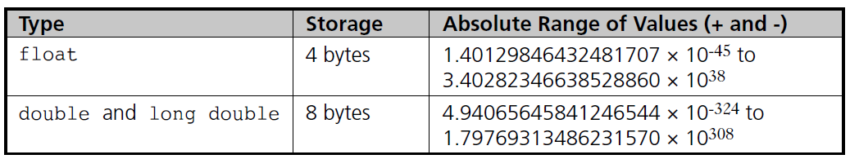
Floating-Point Types (continued)‏
Table 2.6 Floating-Point Data Types
C++ for Engineers and Scientists, Fourth Edition

Slide 36
Floating-Point Types (continued)‏
float literal: Append an f or F to the number
long double literal: Append an l or L to the number
  Examples:
9.234 // a double literal
9.234F // a float literal
9.234L // a long double literal
C++ for Engineers and Scientists, Fourth Edition

Slide 37
Arithmetic Operations
C++ supports addition, subtraction, multiplication, division, and modulus division
Different data types can be used in the same arithmetic expression
Arithmetic operators are binary operators
  Binary operators: Require two operands
  Unary operator: Requires only one operand
  Negation operator (-): Reverses the sign of the number
C++ for Engineers and Scientists, Fourth Edition

Slide 38
Arithmetic Operations (continued)‏
Operation
Operator
Addition
+
Subtraction
-
Multiplication
*
Division
/
Modulus division
%
C++ for Engineers and Scientists, Fourth Edition

Slide 39
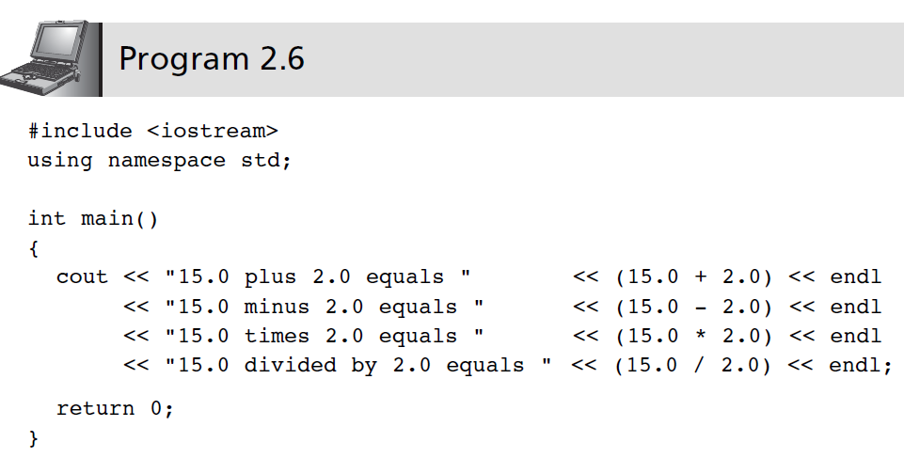
Arithmetic Operations (continued)‏
C++ for Engineers and Scientists, Fourth Edition

Slide 40
Expression Types
Expression: Any combination of operators and operands that can be evaluated to yield a value
If all operands are the same data type, the expression is named by the data type used (integer expression, floating-point expression, etc.)‏
Mixed-mode expression: Contains integer and floating-point operands
  Yields a double-precision value
C++ for Engineers and Scientists, Fourth Edition

Slide 41
Integer Division
Integer division: Yields an integer result
  Any fractional remainders are dropped (truncated)‏
  Example: 15/2 yields 7
Modulus (remainder) operator: Returns only the remainder
  Example: 9 % 4 yields 1
C++ for Engineers and Scientists, Fourth Edition

Slide 42
Operator Precedence and Associativity
Rules for writing arithmetic expressions:
  Never place two consecutive binary arithmetic operators side by side
  Use parentheses to form groupings
    Contents within parentheses are evaluated first
  May nest parentheses within other parentheses
    Evaluated from innermost to outermost
  Use the * operator for multiplication, not parentheses
C++ for Engineers and Scientists, Fourth Edition

Slide 43
Operator Precedence and Associativity (continued)‏
Expressions with multiple operators are evaluated by precedence of operators:
  All negations occur first
  Multiplication, division, and modulus are next, from left to right
  Addition and subtraction are last, from left to right
C++ for Engineers and Scientists, Fourth Edition

Slide 44
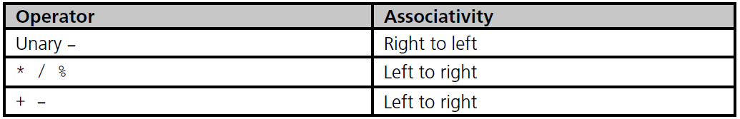
Operator Precedence and Associativity (continued)‏
Associativity: the order in which operators of the same precedence are evaluated
Table 2.8 Operator Precedence and Associativity
C++ for Engineers and Scientists, Fourth Edition

Slide 45
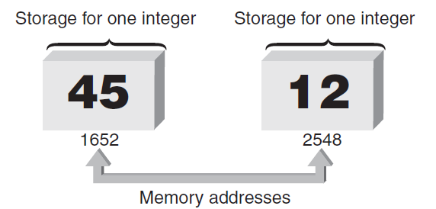
Variables and Declaration Statements
Variable: All integer, float-point, and other values used in a program are stored and retrieved from the computer's memory
Each memory location has a unique address
Figure 2.8 Enough storage for two integers
C++ for Engineers and Scientists, Fourth Edition

Slide 46
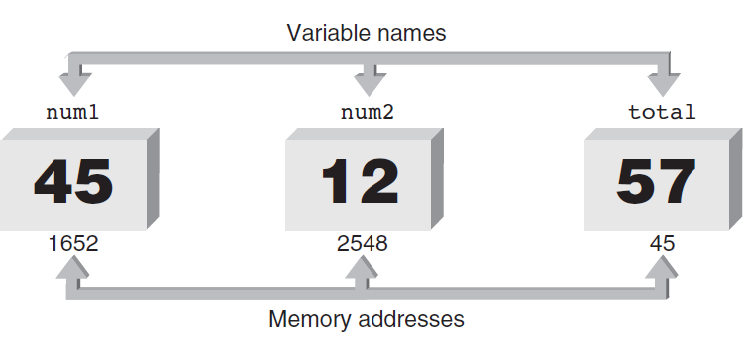
Variables and Declaration Statements (continued)‏
Variable: Symbolic identifier for a memory address where data can be held
Use identifier naming rules for variable names
Figure 2.9 Naming storage locations
C++ for Engineers and Scientists, Fourth Edition

Slide 47
Variables and Declaration Statements (continued)‏
Assignment statement: Used to store a value into a variable
Value of the expression on the right is assigned to the memory location of the variable on the left side
  Examples:
num1 = 45;
num2 = 12;
total = num1 + num2;
C++ for Engineers and Scientists, Fourth Edition

Slide 48
Variables and Declaration Statements (continued)‏
Declaration statement: Specifies the data type and identifier of a variable; sets up the memory location
  Syntax: dataType variableName;
Data type is any valid C++ data type
  Example: int sum;
Declarations may be used anywhere in a function
  Usually grouped at the opening brace
C++ for Engineers and Scientists, Fourth Edition

Slide 49
Variables and Declaration Statements (continued)‏
Character variables: Declared using the char keyword
Multiple variables of the same data type can be declared in a single declaration statement
  Example:
double grade1, grade2, total, average;
Variables can be initialized in a declaration
  Example:
  double grade1 = 87.0
A variable must be declared before it is used
C++ for Engineers and Scientists, Fourth Edition

Slide 50
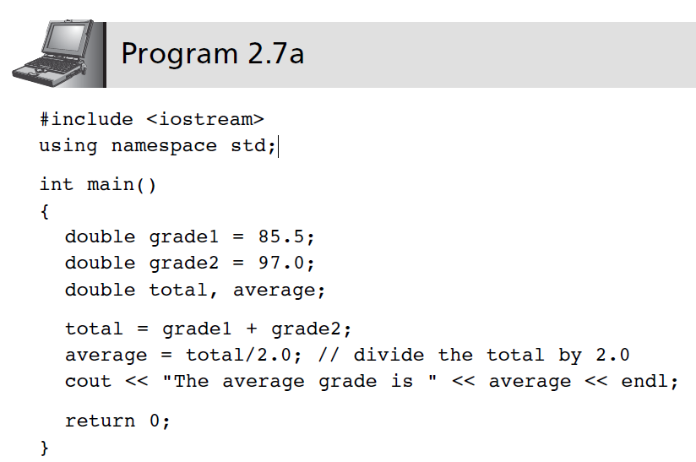
Variables and Declaration Statements (continued)‏
C++ for Engineers and Scientists, Fourth Edition

Slide 51
Memory Allocation
Definition statement: A declaration that defines how much memory is needed for data storage
Three items associated with each variable:
  Data type
  Actual value stored in the variable (its contents)‏
  Memory address of the variable
Address operator (&) provides the variable’s address
C++ for Engineers and Scientists, Fourth Edition

Slide 52
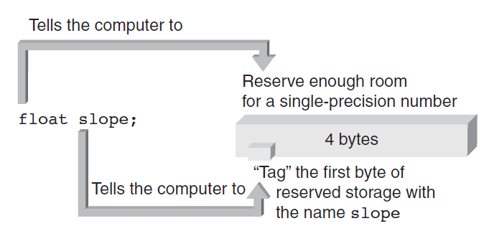
Memory Allocation (continued)‏
Declaring a variable causes memory to be allocated based on the data type
Figure 2.10b Defining the floating-point variable named slope
C++ for Engineers and Scientists, Fourth Edition

Slide 53
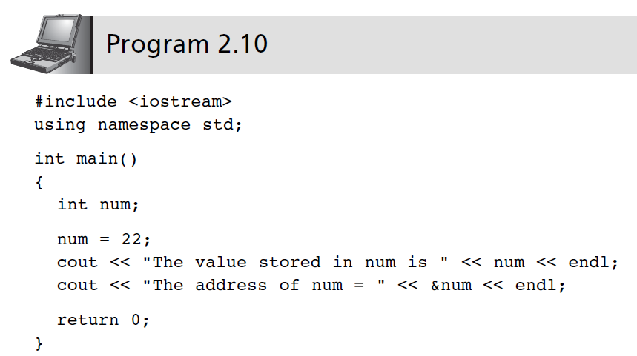
Memory Allocation (continued)‏
C++ for Engineers and Scientists, Fourth Edition

Slide 54
A Case Study: Radar Speed Trap
Step 1: Analyze the Problem
  Understand the desired outputs
  Determine the required inputs
Step 2: Develop a Solution
  Determine the algorithms to be used
  Use top-down approach to design
Step 3: Code the Solution
Step 4: Test and Correct the Program
C++ for Engineers and Scientists, Fourth Edition

Slide 55
A Case Study: Radar Speed Trap (continued)‏
Analyze the Problem
  Output: Speed of the car
  Inputs: Emitted frequency and received frequency
Develop a Solution
  Algorithm:
    Assign values to f0 and f1
    Calculate and display speed
C++ for Engineers and Scientists, Fourth Edition

Slide 56
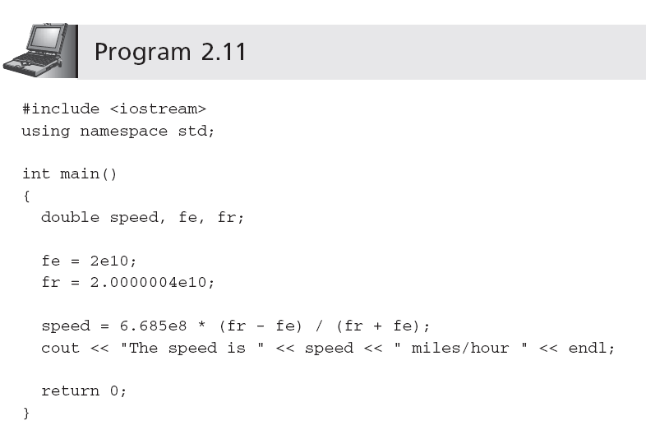
A Case Study: Radar Speed Trap (continued)‏
Code the Solution
C++ for Engineers and Scientists, Fourth Edition

Slide 57
A Case Study: Radar Speed Trap (continued)‏
Test and Correct the Program
  Verify that the calculation and displayed value agree with the previous hand calculation
  Use the program with different values of received frequencies
C++ for Engineers and Scientists, Fourth Edition

Slide 58
Common Programming Errors
Omitting the parentheses after main()‏
Omitting or incorrectly typing the opening brace, {, or the closing brace, }, that signifies the start and end of a function body
Misspelling the name of an object or function
Forgetting to enclose a string sent to cout with quotation marks
Omitting a semicolon at end of statement
C++ for Engineers and Scientists, Fourth Edition

Slide 59
Common Programming Errors (continued)‏
Adding a semicolon at end of #include statement
Missing \n to indicate new line
Substituting letter O for zero and vice versa
Failing to declare all variables
C++ for Engineers and Scientists, Fourth Edition

Slide 60
Common Programming Errors (continued)‏
Storing an incorrect data type into a variable
Attempting to use a variable with no value
Dividing integer values incorrectly
Mixing data types in the same expression
C++ for Engineers and Scientists, Fourth Edition

Slide 61
Summary
A C++ program consists of one or more modules, called functions, one of which must be called main()‏
All C++ statements must be terminated by a semicolon
Data types include int, float, bool, char
cout object can be used to display data
cout object requires the preprocessor command #include <iostream>
C++ for Engineers and Scientists, Fourth Edition

Slide 62
Summary (continued)‏
Variables must be declared with their data type
A variable can be used only after it has been declared
Variables may be initialized when declared
Definition statement causes computer to allocate memory for a variable
sizeof() operator yields the amount of storage reserved for a variable
C++ for Engineers and Scientists, Fourth Edition

